Slide 1
Hadoop – An Introduction

Slide 2
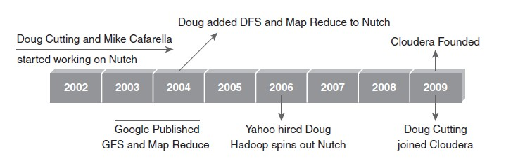
History of Hadoop

Slide 3
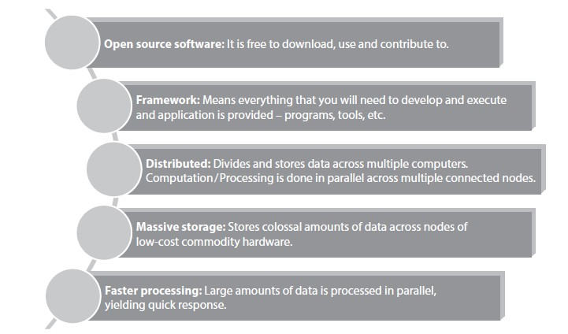
Key Aspects of Hadoop

Slide 4
Hadoop core components
Hadoop Distributed File System (HDFS)
Storage component
Distributes data across several nodes
Natively redundant
Hadoop MapReduce
Computational framework
Splits task across multiple nodes
Process data in parallel.

Slide 5
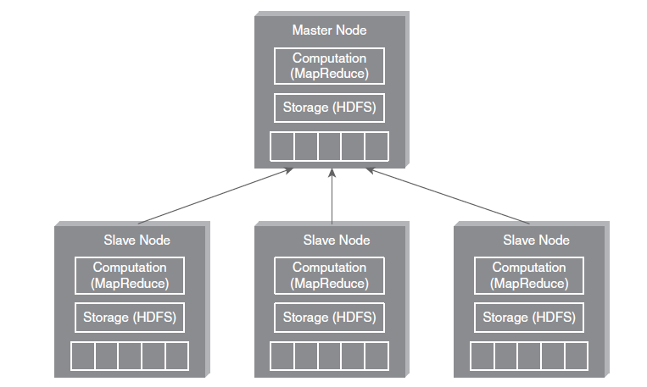
Hadoop High Level Architecture
Name Node
MasterHDFS:
1.partitioning the data storage
2. keep tracks locations
Master MapReduce:
1.Decides and schedule computations task on slave node
Data nodes

Slide 6
HDFS
(HADOOP DISTRIBUTED FILE SYSTEM)

Slide 7
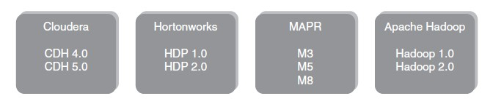
Hadoop Distributors

Slide 8
Hadoop Distributed File System
1. Storage component of Hadoop.
Distributed File System.
Modeled after Google File System.
Optimized for high throughput (HDFS leverages large block size and
moves computation where data is stored).
You can replicate a file for a configured number of times, which is tolerant in terms of both software and hardware.
Re-replicates data blocks automatically on nodes that have failed.
You can realize the power of HDFS when you perform read or write on large files (gigabytes and larger).
Sits on top of native file system such as ext3 and ext4, which is described

Slide 9
HDFS Daemons
NameNode:
Single NameNode per cluster.
Keeps the metadata details
DataNode:
Multiple DataNode per cluster
Read/Write operations
SecondaryNameNode:
Housekeeping Daemon

Slide 10
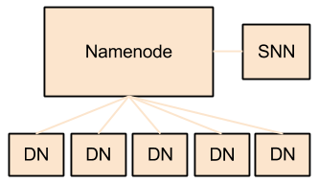
HDFS Daemons
Name node
Data Node
Secondary name node

Slide 11
HDFS Architecture
Namenode
Metadata(Name, replicas..)
(/home/foo/data,6. ..
Metadata ops
Client
Block ops
Read
Datanodes
Datanodes
B
replication
Blocks
Rack1
Write
Rack2
Client

Slide 12
HDFS Daemons- name node
The ‘master’ machine.
It controls all the meta data for the cluster. Eg - what blocks make up a file, and what data nodes those blocks are stored on
HDFS breaks large data into smaller pieces called Blocks.
Default block size is 64MB
NN uses RACKID identify
Rack is a collection of data nodes within cluster.
NN keeps tracks of blocks of a file as it is placed on various Data nodes.
NN manages file related operations such as read, write, create and delete.
Its main job is managing the File System Namespace.

Slide 13
File System Namespace
File system namespace is a collection of files in cluster.
It includes mapping of blocks to file, file properties and it is stored in a file called FsImage.
HDFS supports a traditional hierarchical file organization.
A user or an application can create directories and store files inside these directories.
The file system namespace hierarchy is similar to most other existing file systems;
one can create and remove files, move a file from one directory to another, or rename a file.
The Name Node maintains the file system namespace.
Any change to the file system namespace or its properties is recorded by the Name Node.
An application can specify the number of replicas of a file that should be maintained by HDFS.
The number of copies of a file is called the replication factor of that file. This information is stored by the Name Node.

Slide 14
Name node
Name node uses:
EditLog: To record every transactions that happens to the file system metadata.
FsImage: In which entire fie system is stored.
When NN starts,
It reads FsImage and EditLog from local disk and applies to all transactions from the EditLog to in-memory representation of the FsImage.
.Then it flushes out new version of FsImage on disk and truncates older EditLog because the changes are updated in the FsImage.
Single NN node per cluster.

Slide 15
Data node
where HDFS actually stores the data.
Multiple data nodes per cluster.
It stores each block of HDFS data in a separate file.
Read/Write operations.
Name node and Data node communications.
Name Node
3. Replicates
1. Heart beat
2. No heart beat
Data Node
Data Node
Data Node

Slide 16
Secondary Name node
Secondary Name node - this is NOT a backup name node, but is a separate service that keeps a copy of both the edit logs, and file system image, merging them periodically to keep the size reasonable.
It is better to run Name node and Secondary name node in different machines. ( Memory requirement).

Slide 17
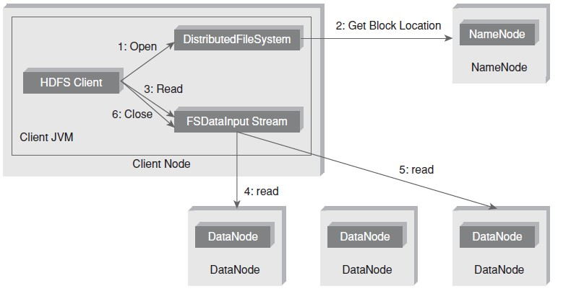
Anatomy of File Read

Slide 18
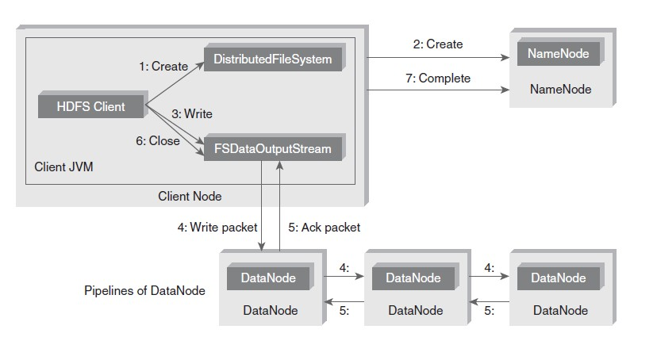
Anatomy of File Write

Slide 19
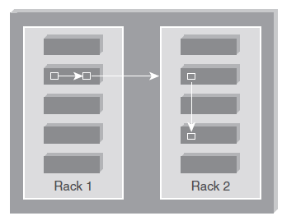
Replica Placement Strategy
As per the Hadoop Replica Placement Strategy, first replica is placed on the same node as the client. Then it places second replica on a node that is present on different rack. It places the third replica on the same rack as second, but on a different node in the rack. Once replica locations have been set, a pipeline is built. This strategy provides good reliability.

Slide 20
Working with HDFS Commands
Objective: To create a directory (say, sample) in HDFS.
Act:
hadoop fs -mkdir /sample
Objective: To copy a file from local file system to HDFS.
Act:
hadoop fs -put /root/sample/test.txt /sample/test.txt Objective: To copy a file from HDFS to local file system. Act:
hadoop fs -get /sample/test.txt /root/sample/testsample.txt

Slide 21
Special Features of HDFS
Data Replication: There is absolutely no need for a client application to track all blocks. It directs the client to the nearest replica to ensure high performance.
Data Pipeline: A client application writes a block to the first DataNode in the pipeline. Then this DataNode takes over and forwards the data to the next node in the pipeline. This process continues for all the data blocks, and subsequently all the replicas are written to the disk.

Slide 22
Processing with Hadoop

Slide 23
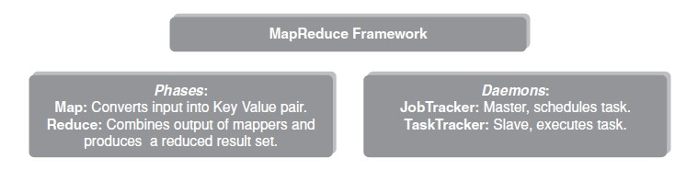
What is MapReduce Programming?
MapReduce Programming is a software frame work. MapReduce Programming helps you to process massive amounts of data in parallel.
Key- value pair

Slide 24
MapReduce daemons
Job Tracker (master) /Cluster
Task Tracker (slave)/Node
Job Configuration: Application + Job parameters

Slide 25
Interaction between Job tracker and task tracker
Client
Job tracker
Task tracker
Task tracker
Task tracker
R
M
R
M
R
M

Slide 26
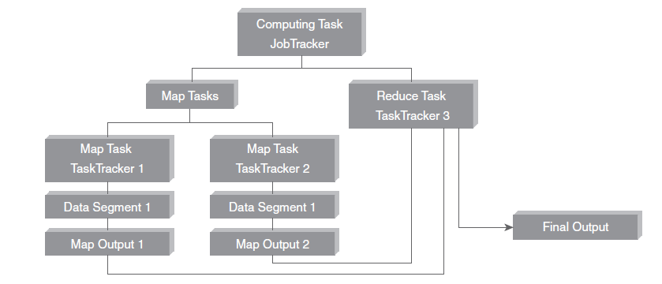
How MapReduce Programming Workflow

Slide 27
MapReduce programming architecture
Input data set is split into multiple pieces of data
Framework creates several master and slave processes
Several map tasks works simultaneously.
Map workers uses partitioner function to divides the data into regions.
Once map is completed reducer work begins

Slide 28
MapReduce – Word Count Example
Input: Text file
Driver class: Job configuration details
Mapper class: Overrides Map function based on the problem statement
Reducer class: Overrides Reduce function based on the problem statement

Slide 29
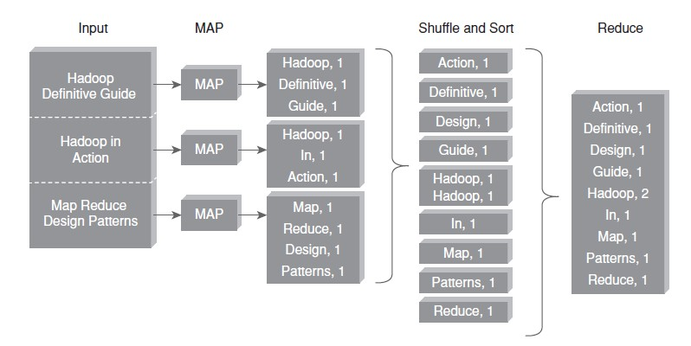
MapReduce – Word Count Example

Slide 30
Main configuartion files
Setup Configuration Files
The following files will have to be modified to complete the Hadoop setup:
~/.bashrc: To setup Java path
hadoop-env.sh: ensures that the value of JAVA_HOME variable will be available to Hadoop whenever it is started up.
core-site.xml: This file can be used to override the default settings that Hadoop starts with.
mapred-site.xml: file is used to specify which framework is being used for MapReduce.
hdfs-site.xml: file needs to be configured for each host in the cluster that is being used. It is used to specify the directories which will be used as the namenode and the datanode on that host.

Slide 31
MANAGING RESOURCES AND APPLICATIONS WITH HADOOP - YARN
(YET ANOTHER RESOURCE NEGOTIATOR)

Slide 32
Limitations of Hadoop 1.0 Architecture
Single NameNode is responsible for managing entire namespace for Hadoop Cluster.
It has a restricted processing model which is suitable for batch-oriented
MapReduce jobs.
Hadoop MapReduce is not suitable for interactive analysis.
Hadoop 1.0 is not suitable for machine learning algorithms, graphs, and other memory intensive algorithms.
5. MapReduce is responsible for cluster resource management and data
processing.

Slide 33
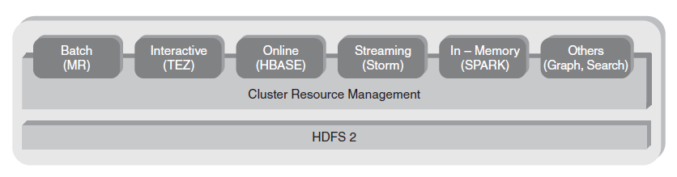
Hadoop 2 YARN: Taking Hadoop beyond Batch

Slide 35
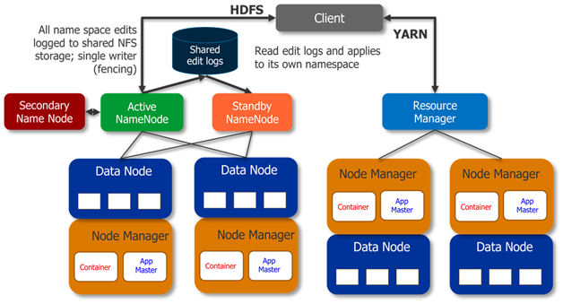
Hadoop 2 YARN: Taking Hadoop beyond Batch

Slide 36
Hadoop 2 YARN: Taking Hadoop beyond Batch
The fundamental idea behind this architecture is splitting the JobTracker responsibility of resource management and Job Scheduling/Monitoring into separate daemons. Daemons that are part of YARN Architecture are described below.
A Global ResourceManager: Its main responsibility is to distribute resources among various applications in the system. It has two main components:
NodeManager: This is a per-machine slave daemon. NodeManager responsibility is launching the application containers for application execution. NodeManager monitors the resource usage such as memory, CPU, disk, network, etc. It then reports the usage of resources to the global ResourceManager.
Per-application ApplicationMaster: This is an application-specific entity. Its responsibility is to negotiate required resources for execution from the ResourceManager. It works along with the NodeManager for executing and monitoring component tasks.

Slide 37
Interacting with Hadoop Ecosystem

Slide 38
Interacting with Hadoop Ecosytem
Pig : Pig is a data flow system for Hadoop. It uses Pig Latin to specify data flow. Pig is an alternative to MapReduce Programming. It abstracts some details and allows you to focus on data processing.
Hive: Hive is a Data Warehousing Layer on top of Hadoop. Analysis and queries can be done using an SQL-like language
Sqoop: Sqoop is a tool which helps to transfer data between Hadoop and Relational Databases. With the help of Sqoop, you can import data from RDBMS to HDFS and vice-versa
HBase: HBase is a NoSQL database for Hadoop. HBase is column-oriented NoSQL database. HBase is used to store billions of rows and millions of columns. HBase provides random read/write operation.

Slide 39
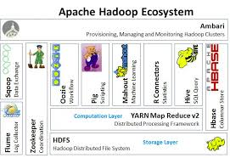
Hadoop eco systems
HDFS
Hbase: Hadoop DB
Ambari: web based tool (clusters)
Zookeeper (managing & monitoring)
Cassandra (database)
Hive, Pig (data warehouse and query
language)
Mahout (machine learning)
Oozie: Scheduler
Sqoop: Transfer bulk of data

